Slide 1

DataDose
PHARMACY PRESCRIPTION SIMULATOR
Realistic pharmaceutical event streaming to Aiven Kafka over SASL_SSL. Powering real-time drug interaction analytics.

Slide 2
Simulating the Future
Bridging the gap between static datasets and real-time event streams.

Slide 3






Core Capabilities
Verified Drug Pool
Realistic Generation
Live Monitoring
Loads INNs from validated CSVs, filtering for ingredient flags and expanding complex combinations.
Real-time progress reporting with formatted tables and session statistics every 50 messages.
Randomizes patient data, pharmacy locations (120 IDs), and patient demographics (Age 18-85).

Slide 4

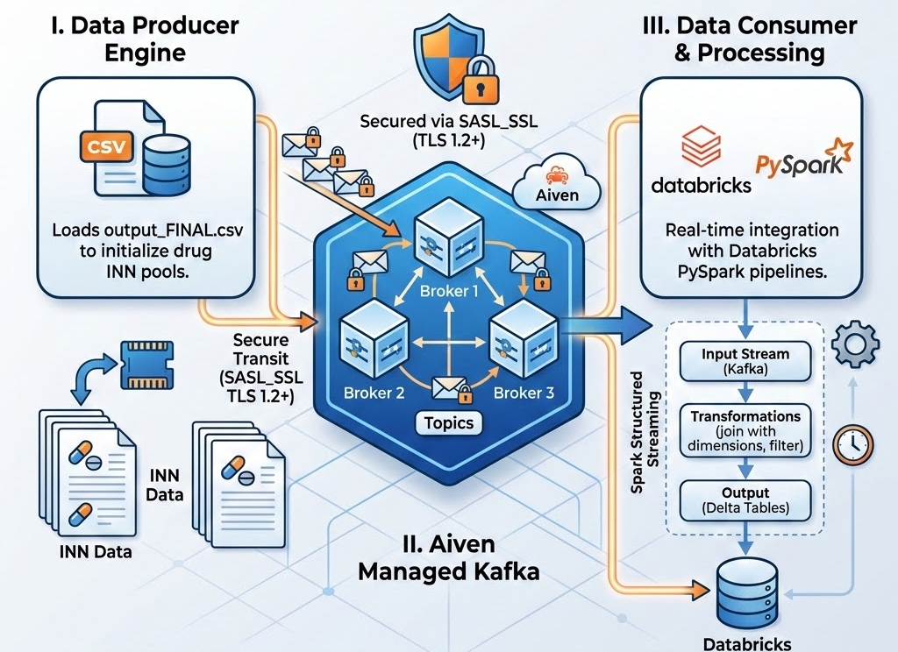
System Architecture
Producer Engine: Loads output_FINAL.csv to initialize drug INN pools.
Aiven Kafka: Secure transit over SASL_SSL (TLS 1.2+).
Data Consumer: Real-time integration with Databricks PySpark pipelines.

Slide 5
Technology Stack
Category | Technology | Implementation Detail
Runtime | Python 3.10+ | Core logic and simulation engine
Kafka Client | kafka-python | SASL/SSL enabled Producer/Consumer
Processing | pandas | Dataset loading and INN expansion
Auth | SCRAM-SHA-256 | SASL authentication against Aiven
Messaging | JSON (UTF-8) | Serialized event payload format

Slide 6
Data Generation Logic
Pharmacy Pool: 120 unique pharmacies with Egyptian city assignments.
Dose Forms: 9 delivery methods (Tablets, Syrups, Inhalers, etc.).
Patient Cohort: 50,000 randomized IDs ensuring data distribution.
Polypharmacy: Randomizes 0–5 current medications per event.
Age Diversity: Realistic range from 18 to 85 years old.
Temporal Data: UTC timestamps generated for event sequencing.

Slide 7

Security & Protocols
Enterprise-grade security is baked into every event transmission.
SASL_SSL: Secure authentication via SCRAM-SHA-256.
Transport: TLS 1.2 minimum enforced on SSL Context.
Certificates: Custom ca.pem validation for broker identity.

Slide 8
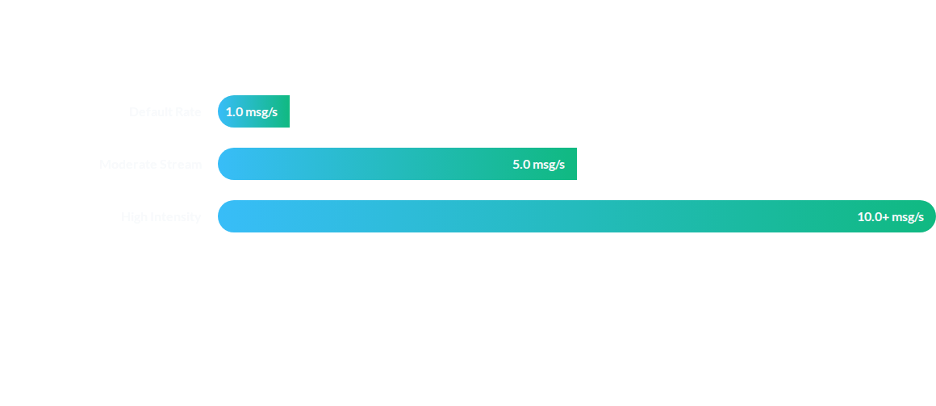
Throughput Performance
The simulator supports sub-second rate adjustment via the --rate flag.

Slide 9


Operational Usage Modes
Dry-Run Mode
Live Production
Prints prescriptions to the console without Kafka connection. Perfect for schema validation and local development.
Connects to Aiven cloud endpoints with full SASL/SSL handshaking for continuous data flow.

Slide 10
Simulation Scale
120
50K
PHARMACY NODES
PATIENT IDS
A realistic Egyptian demographic footprint spanning 25 major cities.

Slide 11
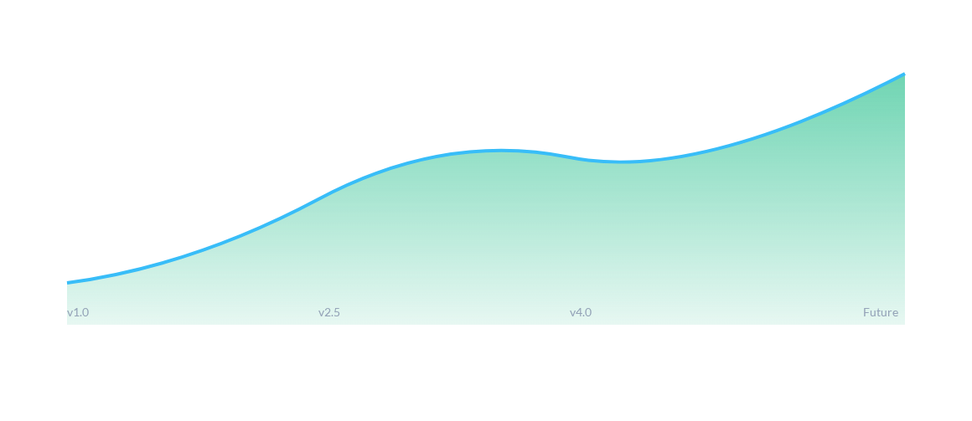
Projected Pipeline Scalability
Continuous improvements in data fidelity and connection resilience.

Slide 12
Questions?
DataDose Pharmacy Simulator v4.2
For more information, please refer to the technical documentation.

